Slide 1

8th Grade Math: Pre-Algebra
Unit 13, Lesson 2 Solving for Unknown Angles Volume 2, pg. 273

Slide 2


Benchmark
MA.8.GR.1.4
Solve mathematical problems involving the relationships between supplementary, complementary, vertical or adjacent angles.
volume 2, pg. 273

Slide 3
Integrated Mathematical Thinking and Reasoning Standards
MA.K12.MTR.4.1 Engage in discussions that reflect on the mathematical thinking of self and others.
MA.K12.MTR.5.1 Use patterns and structure to help understand and connect mathematical concepts.
volume 2, pg. 273

Slide 4

Learning Targets
I can apply angle relationships to find missing angle measures.
I can write and solve algebraic equations to solve for unknown angles.
volume 2, pg. 273

Slide 5

Warm-Up
volume 2, pg. 273

Slide 6
13.2.1 Warm-Up: Agree or Disagree
1. Line segments $MH$ and $RP$ intersect at point $B$.
volume 2, pg. 273

Slide 7
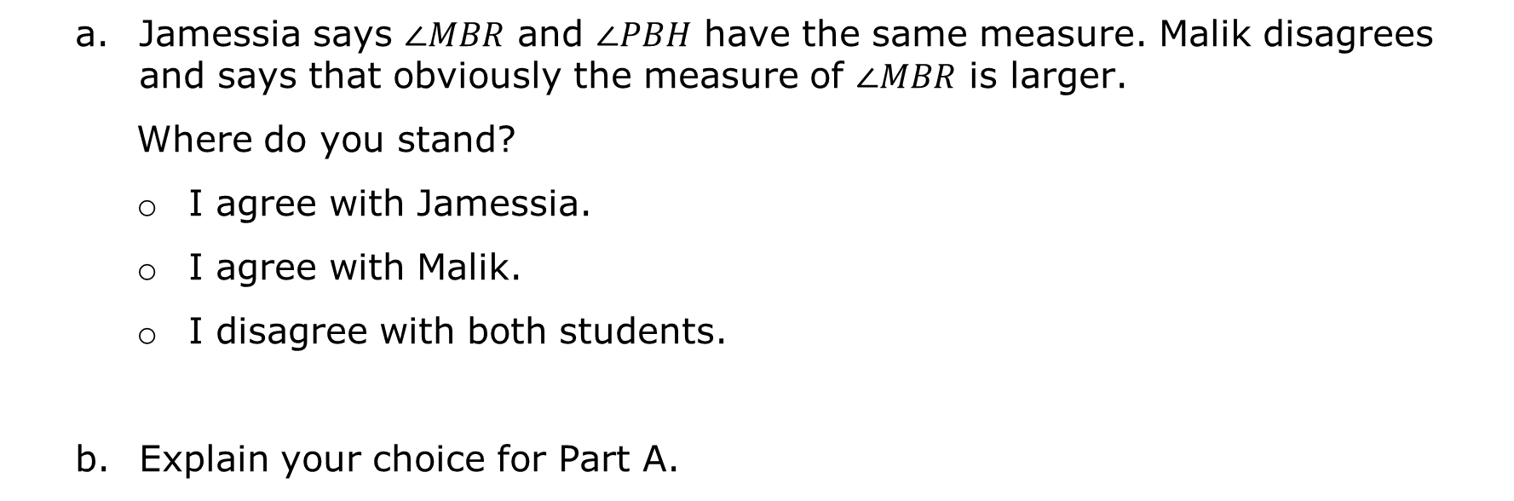
Jamessia says $∠MBR$ and $∠PBH$ have the same measure. Malik disagrees and says that obviously the measure of $∠MBR$ is larger.
Where do you stand?
I agree with Jamessia.
I agree with Malik.
I disagree with both students.
Explain your choice for Part A.
volume 2, pg. 273

Slide 8

Guided Instruction
volume 2, pg. 274

Slide 9
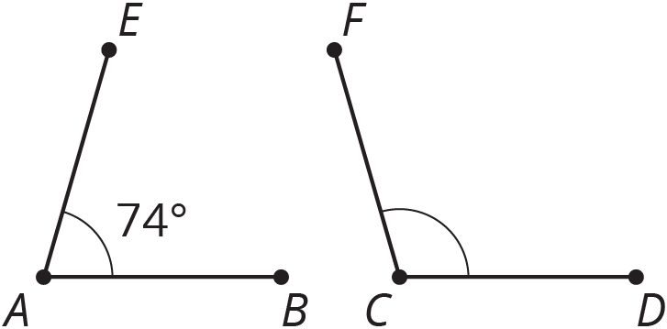

13.2.2 Guided Instruction: Applying Relationships to Find Missing Angles
Angle relationships can be used to solve mathematical problems and find missing angles.
Angles $EAB$ and $FCD$ are supplementary, and the measure of $∠EAB$ is $74°$.
Find the measure of angle $FCD$.
volume 2, pg. 274

Slide 10
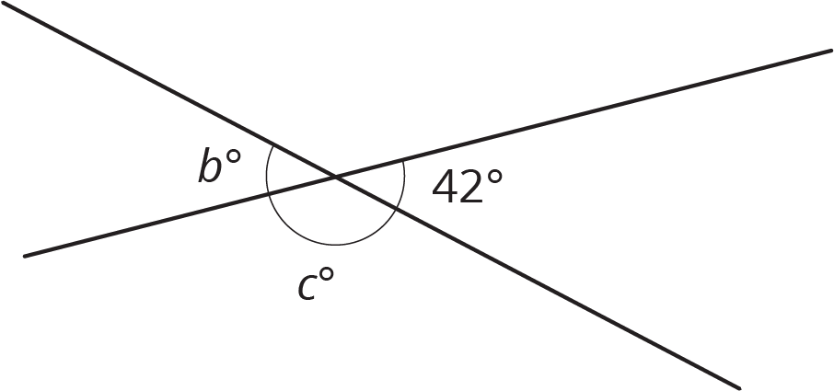
Two line segments intersect, as shown.
Discuss with your partner the relationships between the angles marked in the diagram and how those relationships can be used to determine the missing angle measures.
volume 2, pg. 274

Slide 11
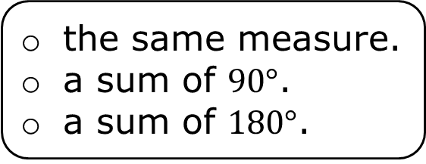
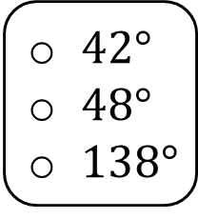



Complete the statements.
The value of $b$ is because angles have
The value of $c$ is because angles have
$42°$
$48°$
$138°$
complementary
supplementary
vertical
the same measure.
a sum of $90°$.
a sum of $180°$.
$42°$
$48°$
$138°$
complementary
supplementary
vertical
the same measure.
a sum of $90°$.
a sum of $180°$.
volume 2, pg. 274

Slide 12
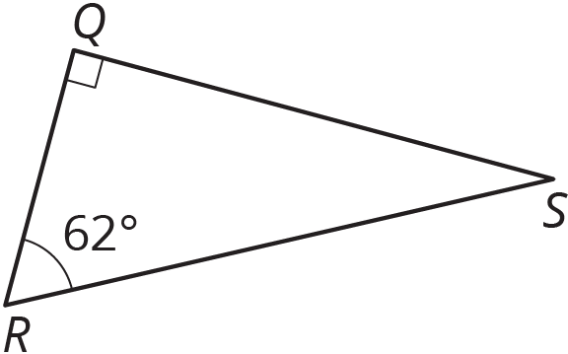
In the figure, angles QRS and RSQ are complementary.
Find the measure of angle RSQ.
volume 2, pg. 274

Slide 13

Collaboration
volume 2, pg. 275

Slide 14

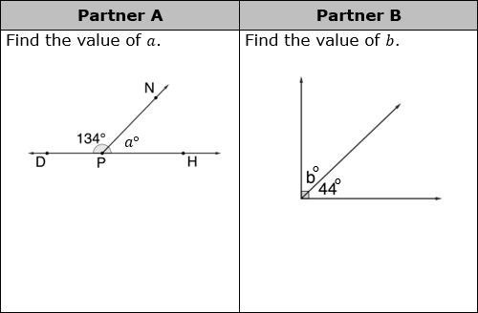
13.2.3 Collaboration: Applying Relationships to Find Missing Angles
With your partner, determine who will be Partner A and who will be Partner B.
Complete the problems in the appropriate column independently.
volume 2, pg. 275

Slide 15
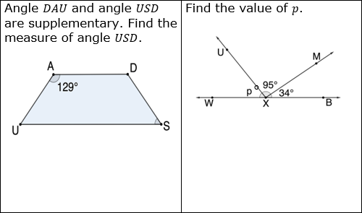
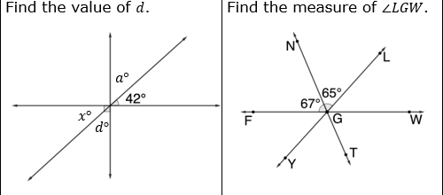
volume 2, pg. 275

Slide 16
The problems in each row have the same result. Check your work with your partner. If there are discrepancies in your answers, work together to find and correct any errors.
volume 2, pg. 275

Slide 17
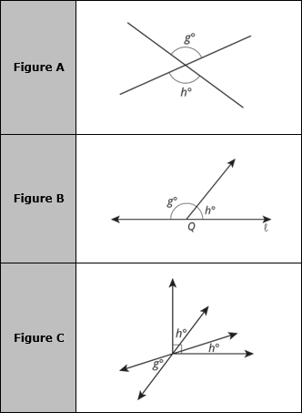
Three figures are shown with angles measuring $g°$ and $h°$ marked in each figure.
volume 2, pg. 276

Slide 18
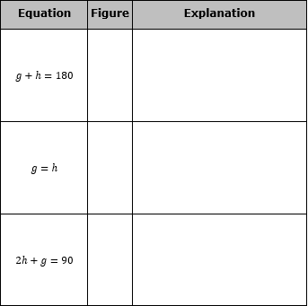
Work with your partner to complete the table by matching each figure to the equation that represents the relationships between the angles in the figure. For each match, explain how you know they are a match.
volume 2, pg. 276

Slide 19

Guided Practice
volume 2, pg. 277

Slide 20

13.2.4 Guided Practice: Writing Equations to Find Missing Angles
Algebraic equations can be written to express the relationship between complementary, supplementary, and vertical angles. The equations can then be solved to find the measures of unknown angles.
Two angles formed by intersecting lines are labeled.
volume 2, pg. 277

Slide 21
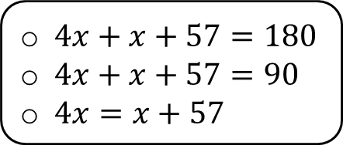
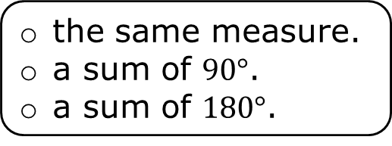

The angles marked are so they have
The equation can be used to find the value of $x$.
complementary angles,
supplementary angles,
vertical angles,
the same measure.
a sum of $90°$.
a sum of $180°$.
$4x+x+57=180$
$4x+x+57=90$
$4x=x+57$
volume 2, pg. 277

Slide 22

Solve for $x$.
Find the measure of each angle using the solution to Part C.
volume 2, pg. 277

Slide 23

Angle $MBY$ is a right angle.
Write an equation that can be used to find the value of $w$.
volume 2, pg. 277

Slide 24
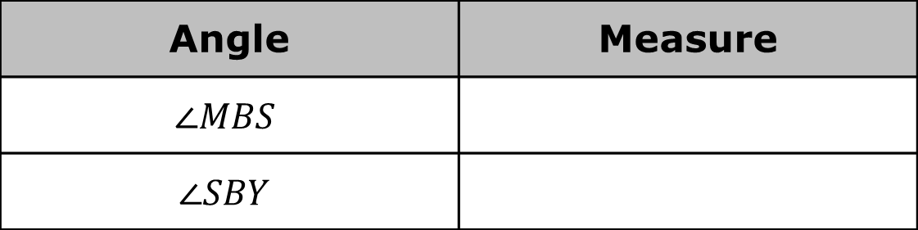
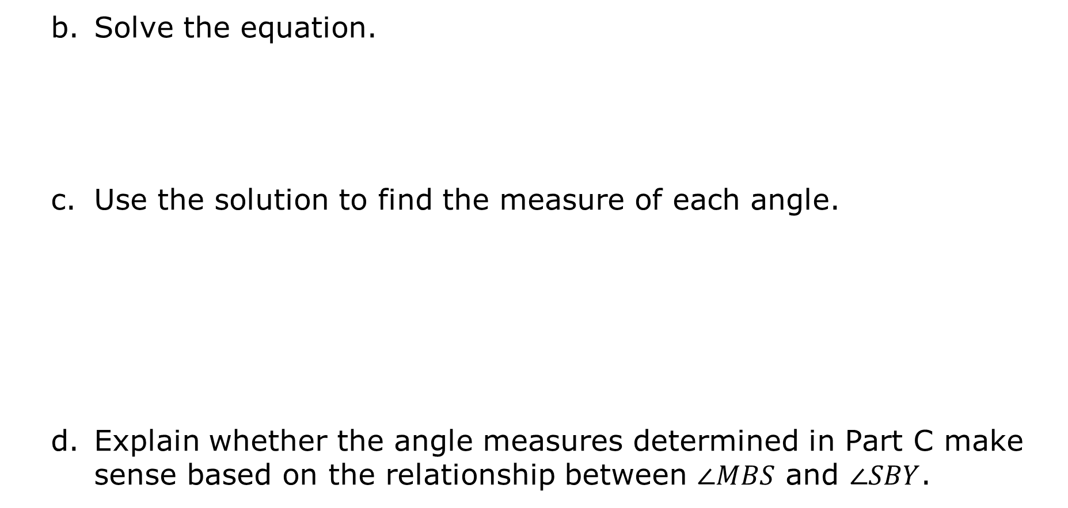
Solve the equation.
Use the solution to find the measure of each angle.
Explain whether the angle measures determined in Part C make sense based on the relationship between $∠MBS$ and $∠SBY$.
Angle | Measure
$$∠MBS$$
$$∠SBY$$
volume 2, pg. 278

Slide 25

Wrap-Up
volume 2, pg. 278

Slide 26

13.2.5 Wrap-Up: Ticket Out the Door
Two angles are labeled in the diagram of line $NZ$, which intersects with line segment $WF$.
Write an equation that can be used to find the value of $d$.
volume 2, pg. 278

Slide 27
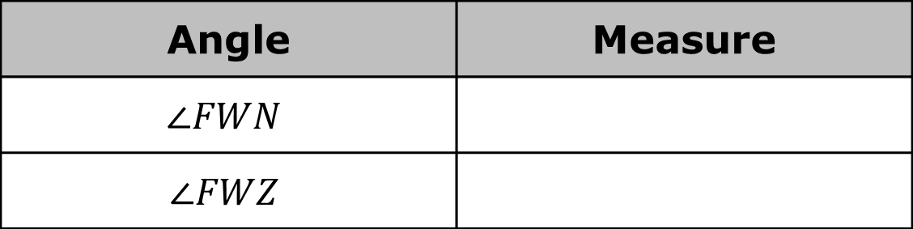
Solve the equation.
Use the solution to find the measure of each angle.
Angle | Measure
$$∠FWN$$
$$∠FWZ$$
volume 2, pg. 278

